Slide 1


Reference
True Positive | False Positive
False Negative | True Negative
Actual leavers
Missed remaining
Prediction
Missed leavers
Actual remaining

Slide 2
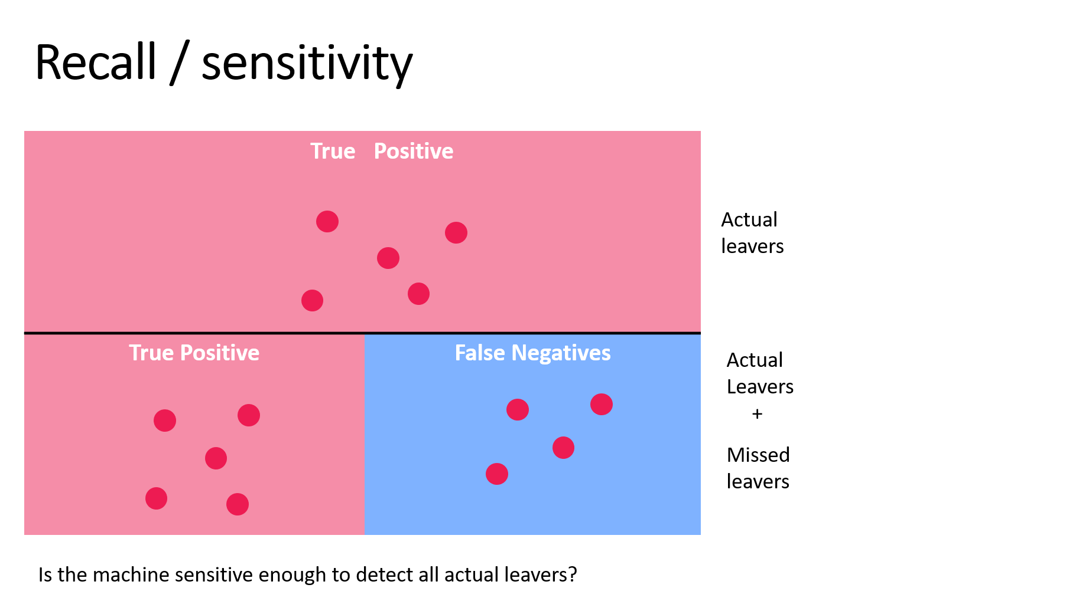
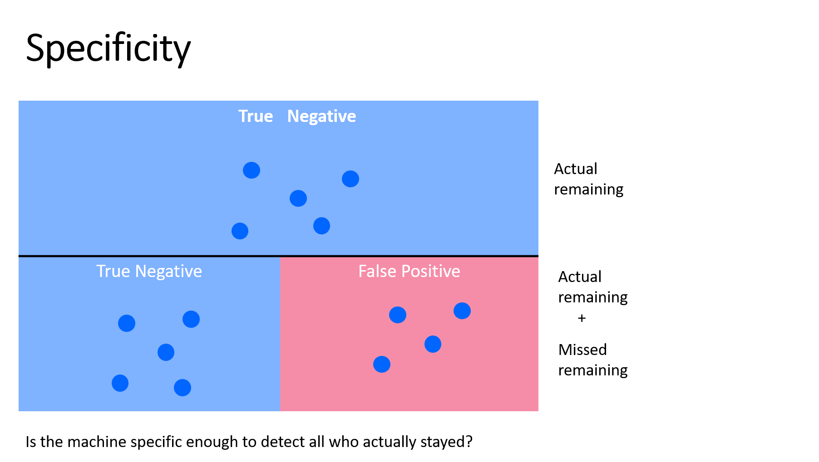
Balanced accuracy
+
2

Slide 3
Recall / sensitivity
True | Positive
True Positive | False Negatives
Actual leavers
Actual
Leavers
+
Missed leavers
Is the machine sensitive enough to detect all actual leavers?

Slide 4
Precision / positive predictive value
True | Positive
True Positive | False Positive
Actual leavers
Actual
leavers
+
Missed remaining
Is the machine accurate enough to differentiate between actual leavers and fake leavers?

Slide 5
Specificity
True | Negative
True Negative | False Positive
Actual remaining
Actual
remaining
+
Missed remaining
Is the machine specific enough to detect all who actually stayed?

